Slide 1

IMPLANTABLE MICROELECTRONIC DEVICE:
DESIGN AND TEST OF MICROELECTRONIC DEVICE FOR OPTOGENETIC APPLICATIONS

Slide 2
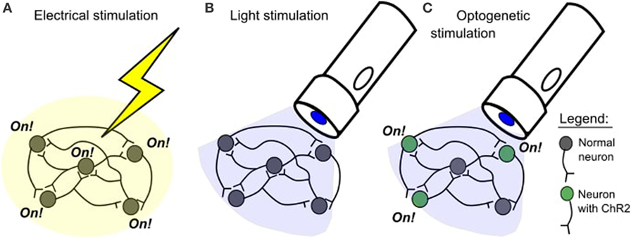
1. OVERVIEW OF THE PROJECT
Wireless Power Supply
Purpose of the project
Microelectronic Device
Optogenetics Technique
Lim, D. H., & LeDue, J. (2017) What Is Optogenetics and How Can We Use It to Discover More About the Brain?. Frontiers for young minds.
Restrictions
Low power device
(Just to supply a LED)
Wireless Power
(Magnetic coupling power harvesting)
Flexible substrate
(must be adaptable to the Surface)
Biocompatibility
(encapsulation is crutial)

Slide 3
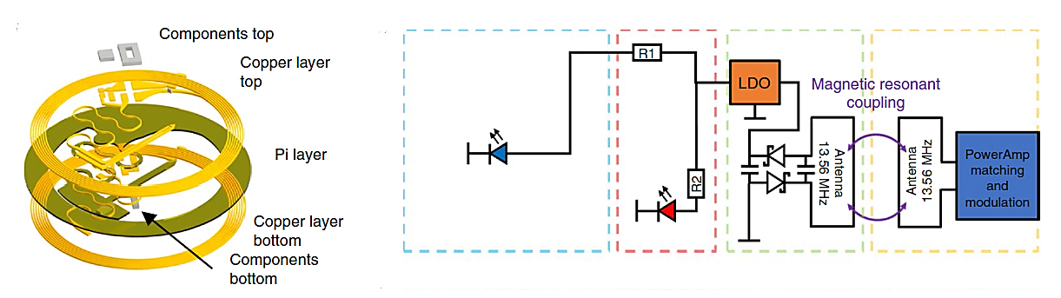
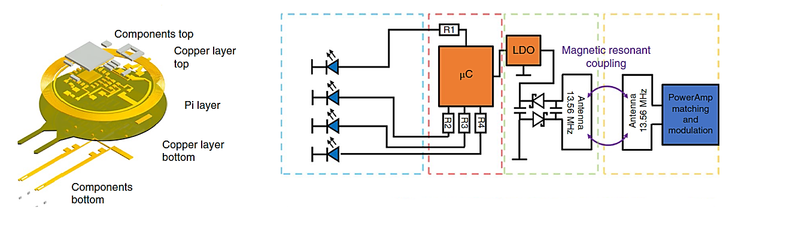
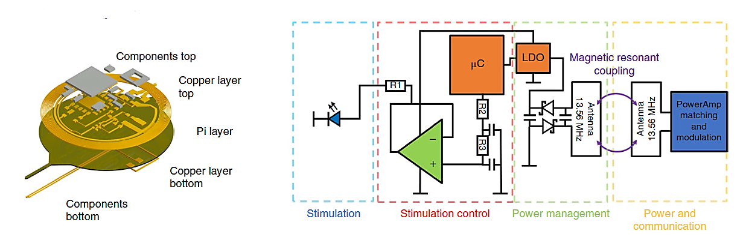
2. PREVIOUS SIMILAR WORKS
John Rogers’ Research Group → Different designs from the most simple to “higher” complexity.
In their work Fully implantable optoelectronic systems for battery-free, multimodal operation in neuroscience research (2018) in Nature Electronics:
1
2
3

Slide 4
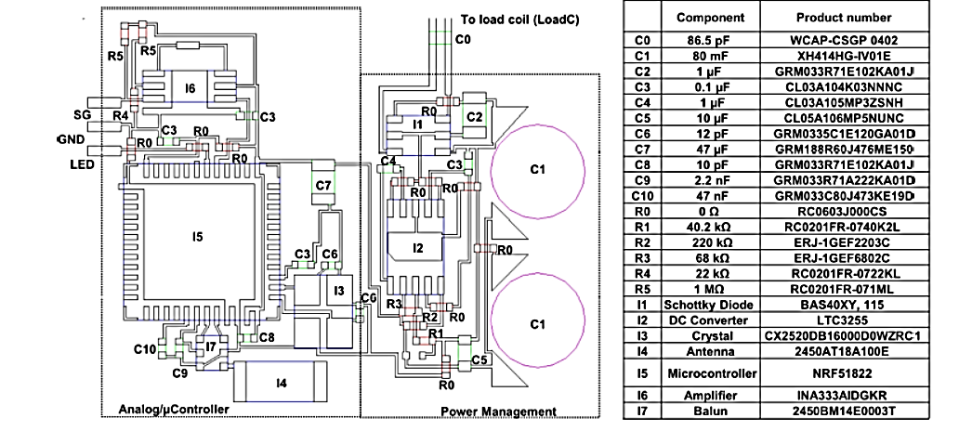
2. PREVIOUS SIMILAR WORKS
John Rogers’ Research Group → Different designs from the most simple to “higher” complexity.
In their work A wireless closed-loop system for optogenetic peripheral neuromodulation (2019) in Nature:
Mickle, A. D., Won, S. M., … Rogers, J.(2019). A wireless closed-loop system for optogenetic peripheral neuromodulation. Nature, 565(7739), 361.

Slide 5
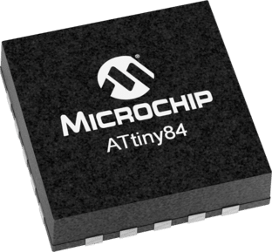
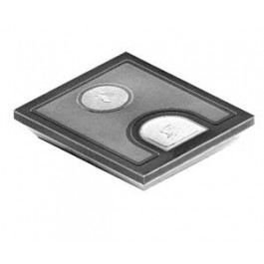
2. PREVIOUS SIMILAR WORKS
John Rogers’ Research Group → Different designs from the most simple to “higher” complexity.
In their work Fully implantable optoelectronic systems for battery-free, multimodal operation in neuroscience research (2018) in Nature Electronics:
Technical Features
Substrate: Pyralux AP8535R, a flexible substrate for bioimplantable devices.
Microcontroler (µC ): ATtiny84(Atmel) → many documentation available.
LDO: NCP161 ON semiconductor → Good specs. for low power device.
Cree® TR2227™ LEDs→ 3.15 V and 20mA.
Other passive components: 0201 and 0402 package size.
Possible Problems
Accesibility to the µC: just once before the surgery.
Temperature of the implant due to the µC performance.
Biocompatibility problema when adding a µC in an implant (soldering components, resins, etc)

Slide 6
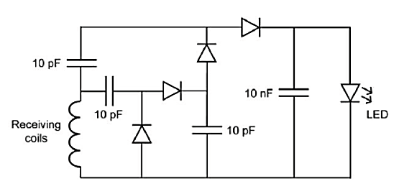
2. PREVIOUS SIMILAR WORKS
Ada Poon’ Research Group → Simple design with a magnetic coupling.
Ho, J. S., Tanabe, Y., Iyer, S. M., Christensen, A. J., Grosenick, L., Deisseroth, K., ... & Poon, A. S. (2015). Self-tracking energy transfer for neural stimulation in untethered mice. Physical Review Applied, 4(2), 024001.

Slide 7
2. PREVIOUS SIMILAR WORKS
Ada Poon’ Research Group → Simple design with a magnetic coupling.
Technical Features
Magnetic Coupling: Three turn coil with SMD capacitor (4pF) and resonant frequency of 1.5GHz.
Power consumption: approximately 4W.
Possible Problems
Designed for only 1 or more leds working at the same pulse.
No control structure implemented.
Usage of non biocompatible-flexible substrate.

Slide 8
3. IDEAS FOR IMPROVEMENT
Using a microcontroller inside the brain increases the size of the implant so far.
For more that one µILED they used a µC → What about using different frequencies for powering different µILEDS?
Problems found
Fixed antenna with helmet or subdermal implant on the patient.
Poon’s device → improve substrate, technical characteristics (Using CREE LED) and improving the power management on the circuit (Light intensity of the LE, temperature, power consumption, etc).

Slide 9

3. IDEAS FOR IMPROVEMENT
Next Steps
1 week
1. Learn about magnetic coupling
2. Run a test with the Ada Poon’s Proposed Circuit
2 weeks
1 weeks
3. Run a test with the John Rogers Proposed Circuit
Check my repository on github and share your info: https://github.com/GGChe/BioImplantableDevice

